Slide 1
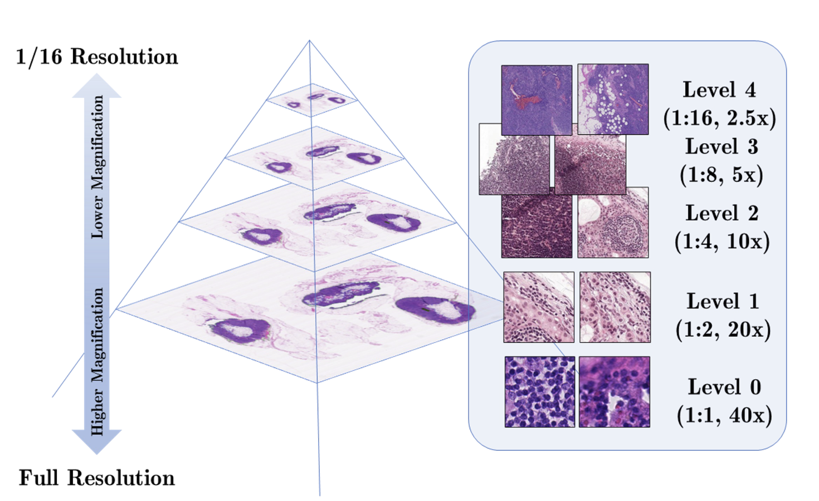
What is a WSI?
Definition: Scanning a complete microscope slide to create a single high-resolution digital file.
Process: Capturing many small high-resolution image tiles and montaging them to create a full image.
Impact: Transforming laboratory workflows by enabling efficient storage, access, analysis, and sharing of digital slides.

Slide 2
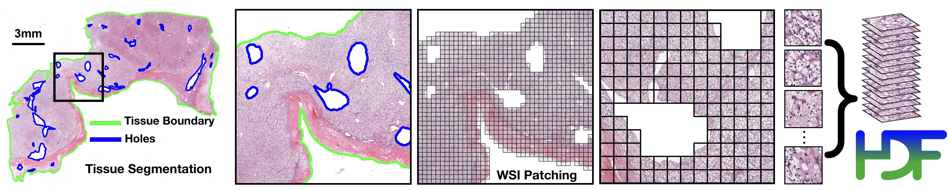
CLAM
Capability: CLAM is a high-throughput and interpretable method for data efficient whole slide image (WSI) classification.
Advantage: CLAM can handle multi-class subtyping problems and adapt to independent test cohorts of WSI resections and biopsies as well as smartphone microscopy images.
Feature: CLAM does not require any ROI extraction or patch-level annotations.

Slide 3
How CLAM works?
Method Type: Deep-learning-based weakly-supervised method.
Purpose: Accurately classify whole slides by identifying sub-regions of high diagnostic value.
Key Technique: Attention-based learning and instance-level clustering.

Slide 4
How we integrated CLAM in our work
CLAM Integration: Integrated CLAM for image preprocessing, specifically extracting patches from TIF or SVS files
CLAM Output: Generates three directories (masks, patches, stitches) and a CSV file containing metadata and variables used for patch creation
Patch Format: Patches are stored in H5 format and converted to JPG for usability

Slide 5
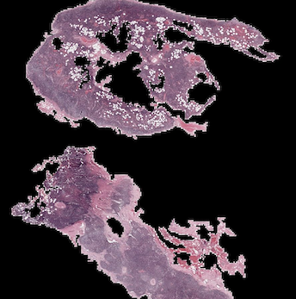
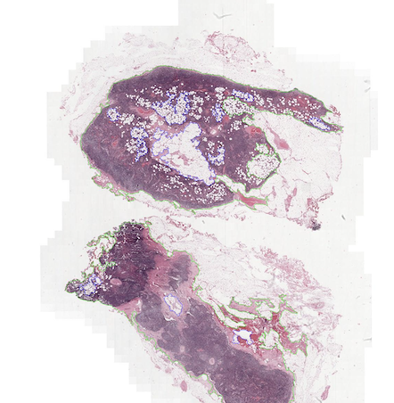
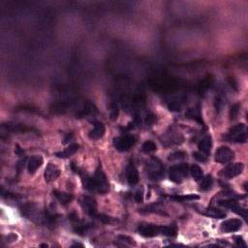
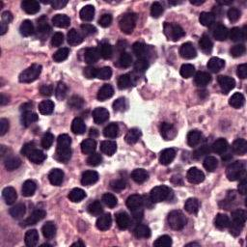
Some examples
Starting from the slide, CLAM generates the stitches, masks and patches

Slide 6
What is Cellpose?
Cellpose is a generalist algorithm for cellular segmentation
Can be very precise on segmenting a wide range of image types out-of-the-box

Slide 7
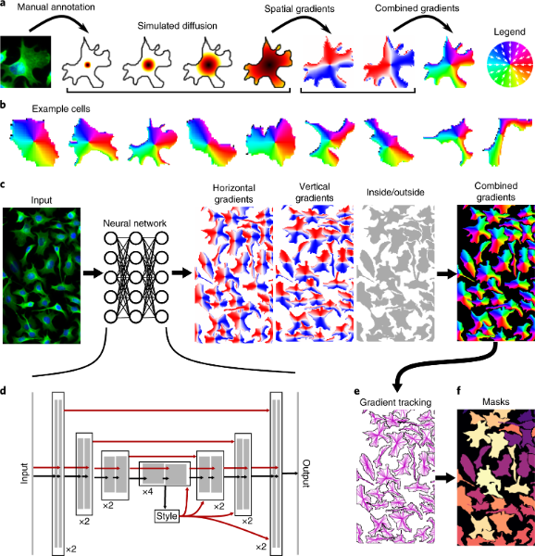
How it works?
Generate an auxiliary representation for the mask – an energy function for each mask as the equilibrium distribution of a heat-diffusion simulation with a heat source placed at the center of the mask
The horizontal and vertical gradients of the energy function form a reversible representation of the masks in a format that can be predicted directly by a neural network

Slide 8
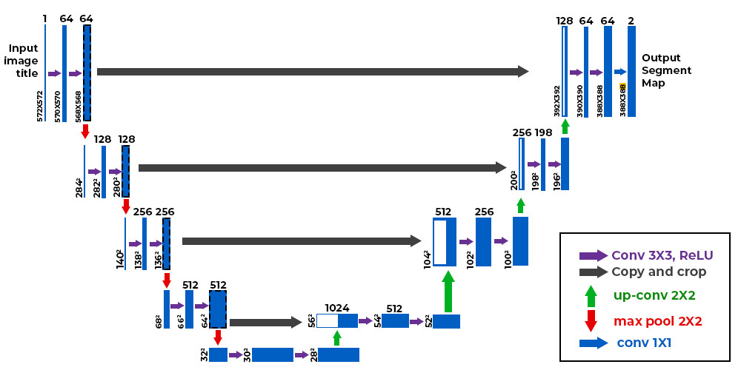
In addition to the two spatial gradient maps, we predict a third map which classifies pixels as inside or outside of cells, which helps to precisely predict cell boundaries
Finally, we recover the predicted masks by running the gradient ascent procedure on the pixels with probabilities greater than 0.5
The neural network that predicts the spatial flows was based on the general U-NET architecture

Slide 9
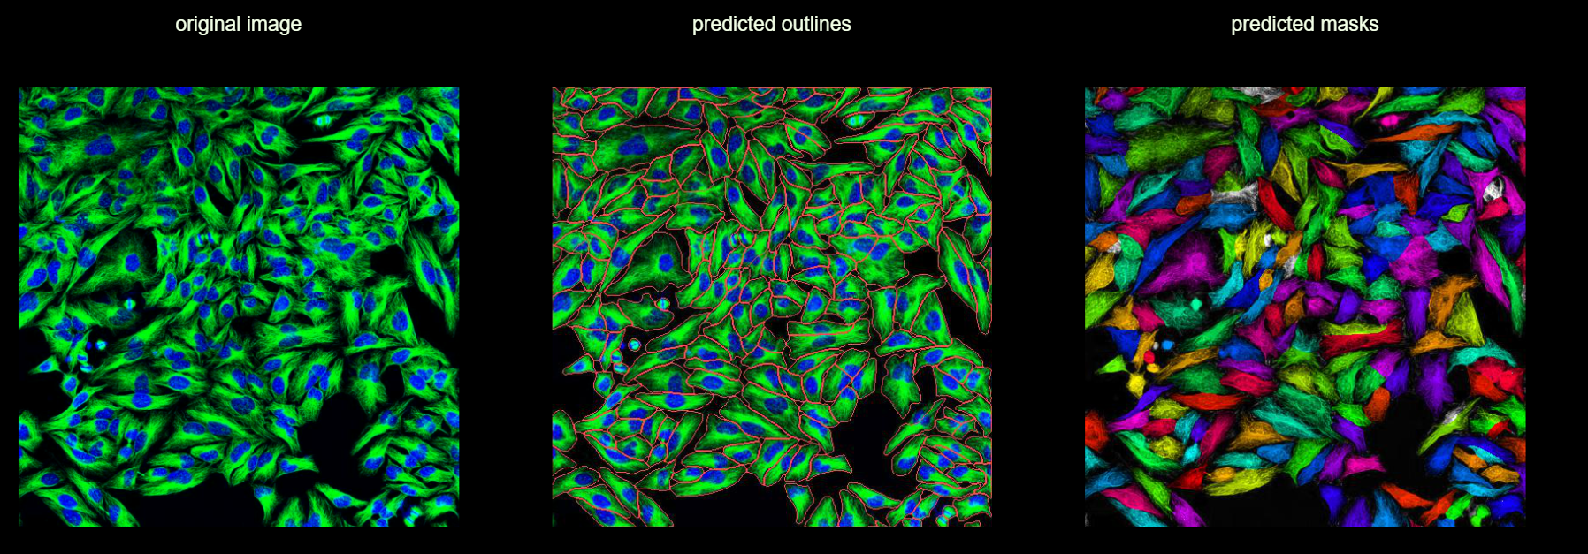
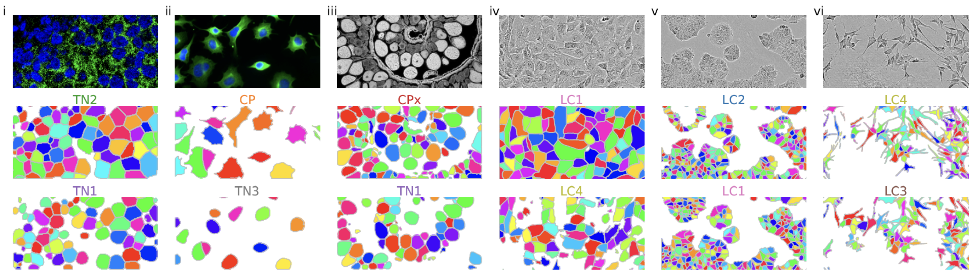
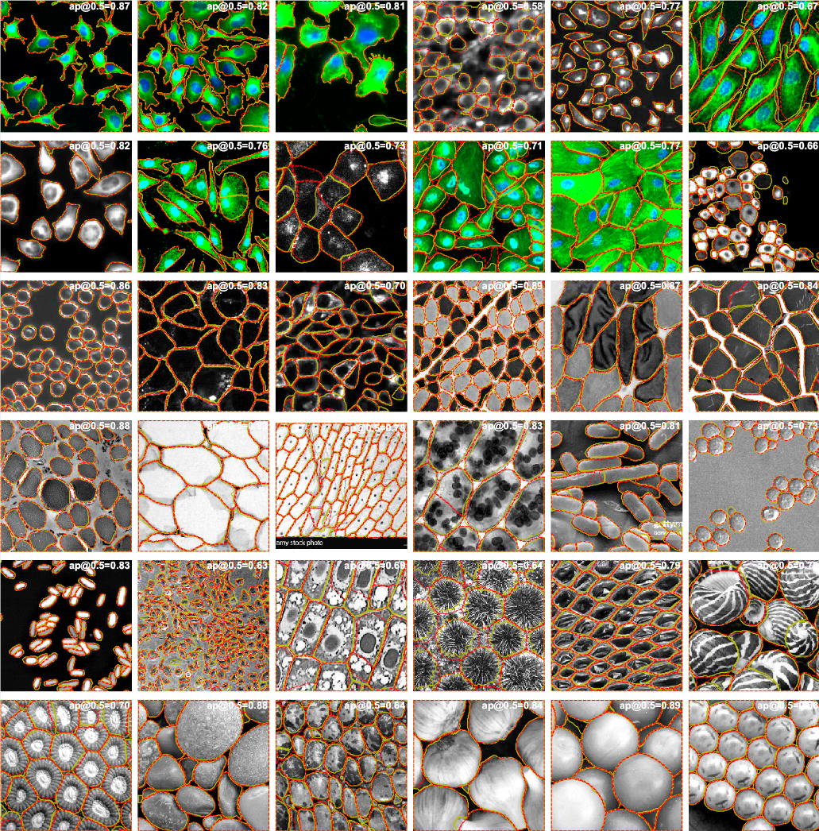
Project integration
There are several pretrained segmentation models
We tried many models to segment our patches
We used cyto3 model for a better integration

Slide 10
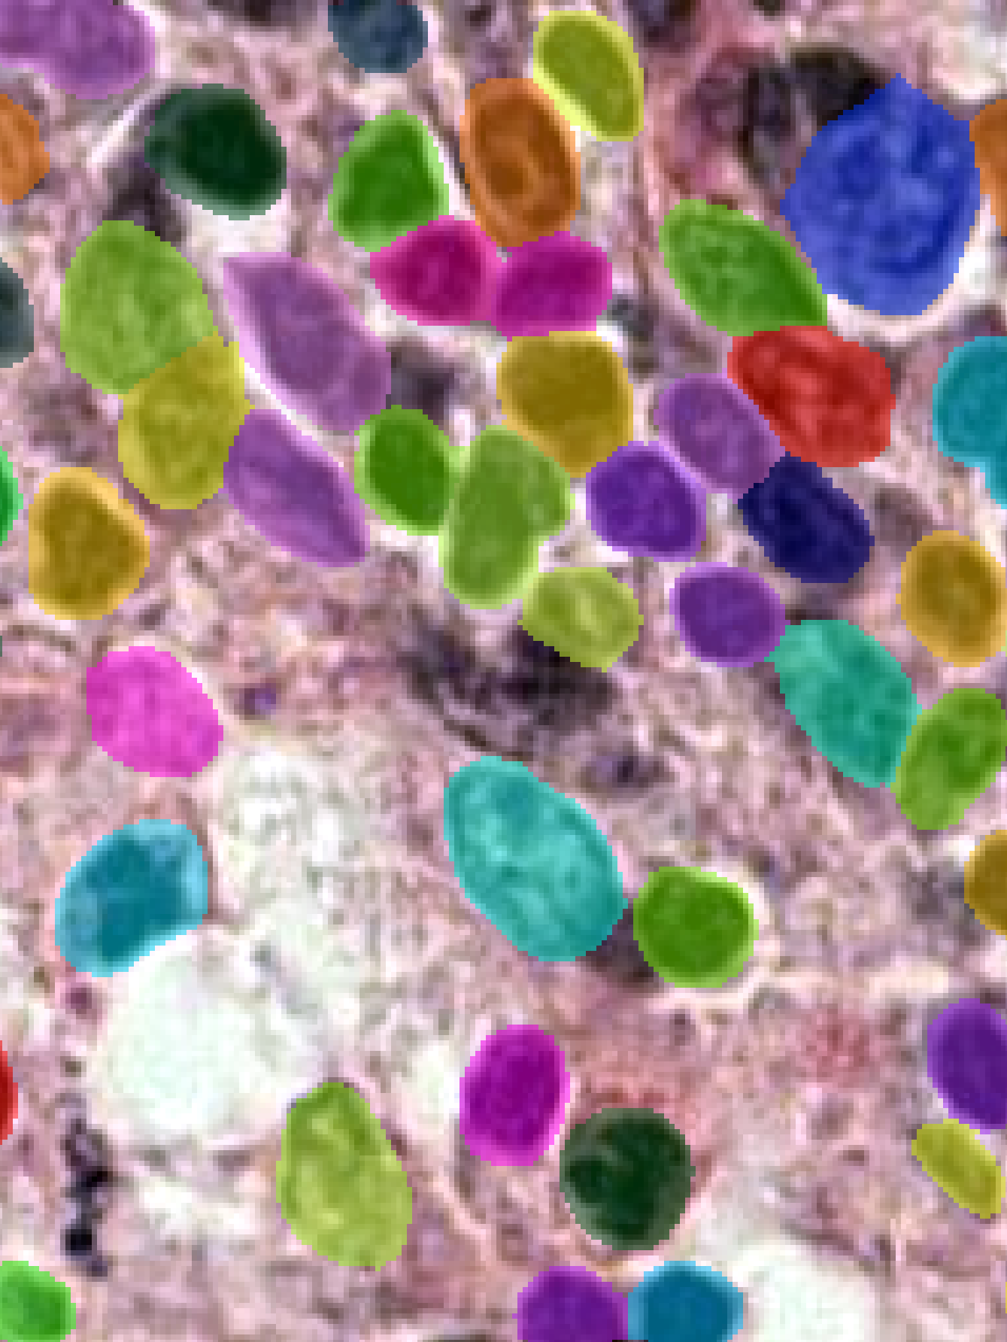
Here is an example of application

